Slide 1
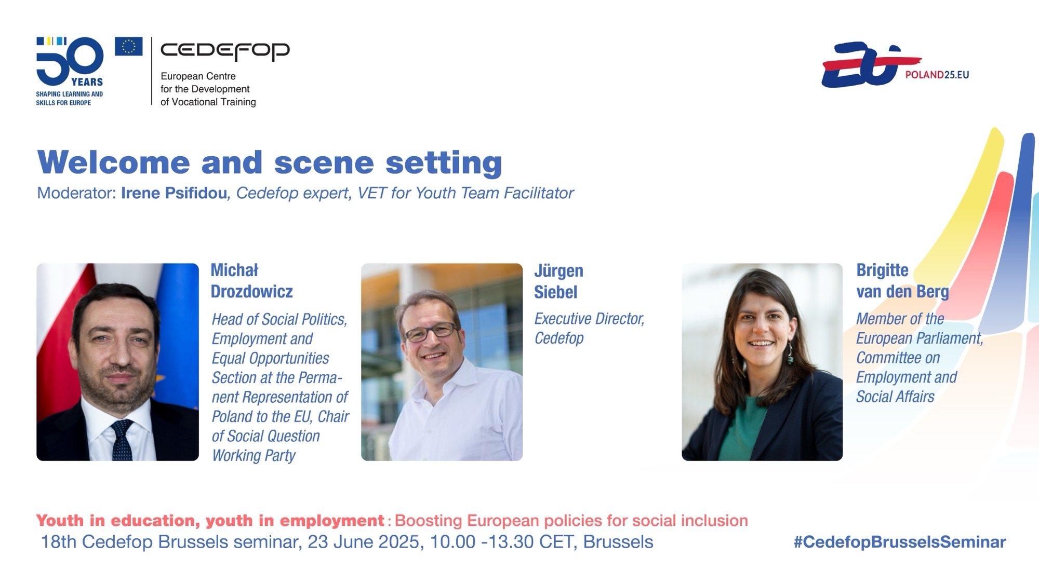

Slide 2
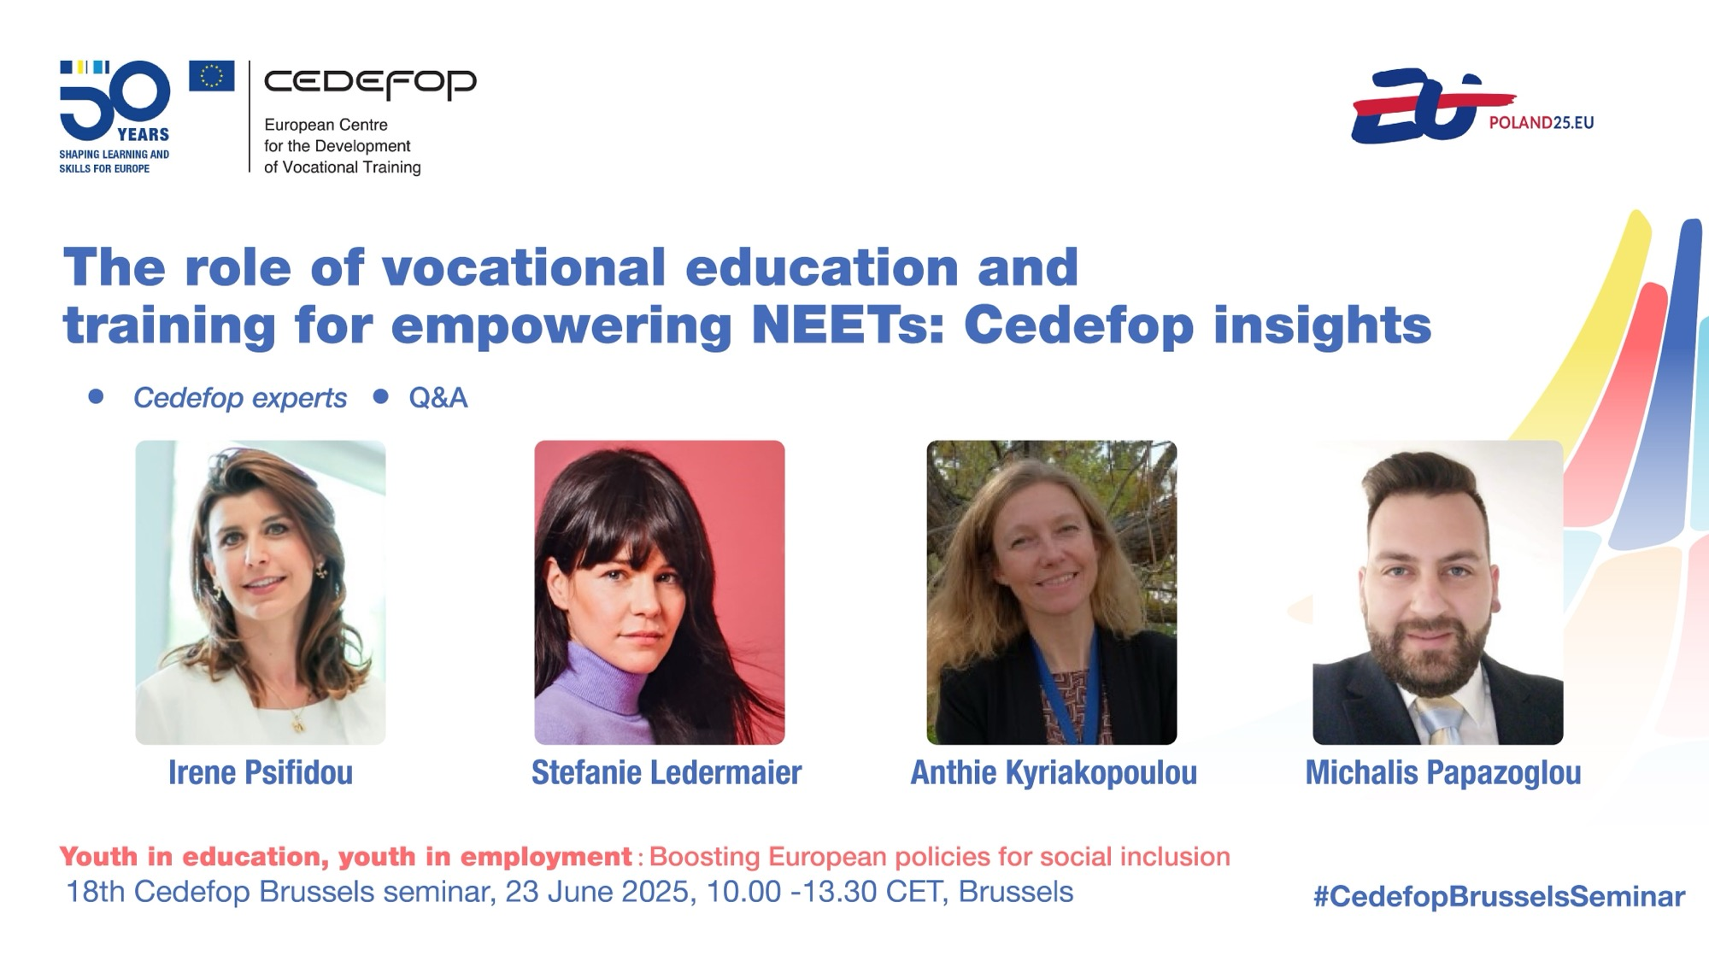

Slide 3
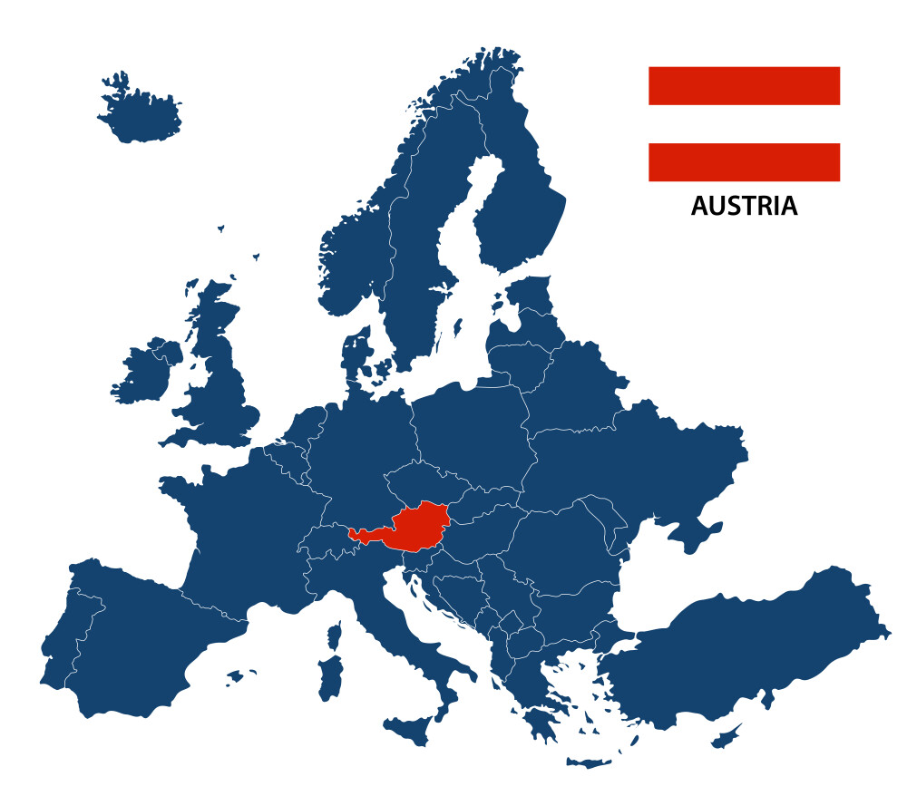
8 million young people in Europe are NEETs
The size of an EU member state

Slide 4
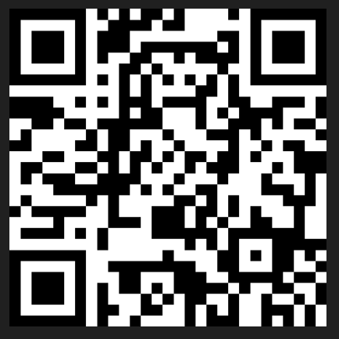
Join at
Slido.com #3596 385
In your opinion, why are NEETs an important policy issue?
Are you directly involved in supporting NEETs?
Are you aware of initiatives targeting NEETs?
In your opinion, how could NEETs be best supported?

Slide 5


Decreasing rates of NEETs but persisting challenges
8
Overall economic development since 2009 crisis
  million NEETs in the EU in 2024
Targeted Member states interventions
COVID-19
Support by EU policy framework
Source: Eurostat, LFS, 2024
Notes:
State of play NEETs
In 2024, around 8 million young people in the EU were NEETs, a total of 11% (aged 15-29 years) (after peak of 2009 crisis, NEET stats starting for EU27 15 years ago – a bit of an overview) – sensitivity to crisis – also shown in the COVID-19 pandemic – direction of preparedness, impact of YG introduction – story telling (frame as progress made)
EU target
Reducing NEET rate to 9% by 2030 (overview of MS which have reached this, like NL etc) – VET as a solution
Significant gender gap & regional disparities (frame as challenges)
Gender (general diff, growing age, ideally with educational attainment and family responsibilities) Across the EU, more women than men are NEETs (12.5% compared to 10.1%) Michalis pls check
Rural: across MS and in MS (NUTs 2 – urban-rual disparity, RO, BU, EL, ES) In some Member States a gap of 10 pps

Slide 6


EU policy framework supporting NEETs
2013 Youth Guarantee Council Recommendation
2014 Youth Guarantee Implementation Plans
2016 Skills Agenda
2017 European Pillar of Social Rights Declaration
2020 Reinforced Youth Guarantee and updated Youth
    Guarantee Implementation Plans
2020 New European Skills agenda – Pact for Skills
2020 Council Recommendation on VET
2020 Osnabrück Declaration
2021 European Pillar of Social Rights Action Plan
2021-2027 European Social Fund Plus (ESF+)
2021 ALMA (Aim, Learn, Master, Achieve)
2025 Union of Skills
2025 Forthcoming Herning Declaration

Slide 7
Progress made towards the EU target
EU strategic objective: NEET rate 9% by 2030
Nine (9) Member states have already met this goal
Five (5) are close to achieving the target: currently below 10%
Eight (8) are far from reaching it: currently above 12%
Source: Eurostat, LFS, 2024

Slide 8


Gender gap in NEETs rates
12.1% NEETs are women
vs. 10% men in 2024
!
Source: Eurostat, LFS, 2024
Notable gender disparities within member states
Inverted picture in five (5) Member States
Notes:
e.g. Romania (Women: 25.2% - Men: 14%) and Czechia (Women: 13.3% - Men: 3.9%)
Inverted picture in few member states Estonia, Finland, Belgium, Sweden, Norway (more male than female)

Slide 9



Regional inequalities:
Remote NEETs at greater risk
10%
Cities
Significant rural-urban disparities
In some Member States this divide is above 10 percentage points
Rural areas often face structural disadvantages
11.4%
Towns & suburbs
12.3%
Rural areas
Source: Eurostat, LFS, 2024
Notes:
The difference between rural and urban - In some Member States like Romania, Bulgaria and Hungary, this divide exceed 10 percentage points higher in rural areas
Rural areas often face structural disadvantages including limited access to quality education, fewer employment opportunities, and weaker infrastructure, making young rural populations particularly vulnerable. –STE: please check this

Slide 10

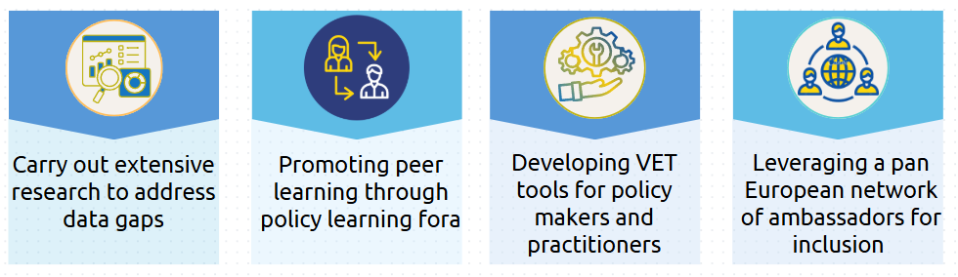
Cedefop’s work on
NEETs and inclusion

Slide 11


Cedefop knowledge hub on inclusion
VET toolkit for tackling early leaving
www.cedefop.europa.eu/TEL-toolkit
VET toolkit for empowering NEETs
www.cedefop.europa.eu/en/tools/neets
Notes:
Cedefop’s VET toolkit for tackling early leaving and VET toolkit for empowering NEETs are valuable sources of support to VET practitioners and policy-makers. These interactive toolkits help them design, implement and evaluate measures for tackling early leaving and supporting early leavers and NEETs. They are constantly enriched with resources (good practices, tools, publications and statistics).
Cedefop is an actor which has been gathering a lot of data – question of how to be most of service to our stakeholders – therefore created 2 toolkits - for practitioners and policy makers – a one-stop-shop on the topics of early leaving of VET and NEETs, supported by a network of ambassadors
Success story of the toolkits: how much used by policy makers and practitioners and mention network of ambassadors – the useability has always been the focus of it

Slide 12
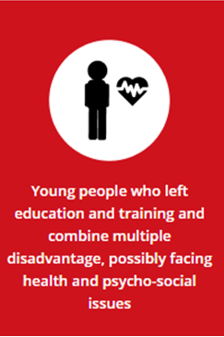

From early leaver to NEET

Slide 13
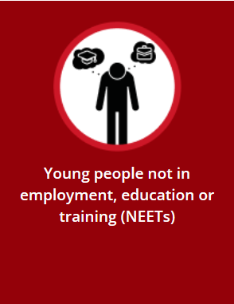
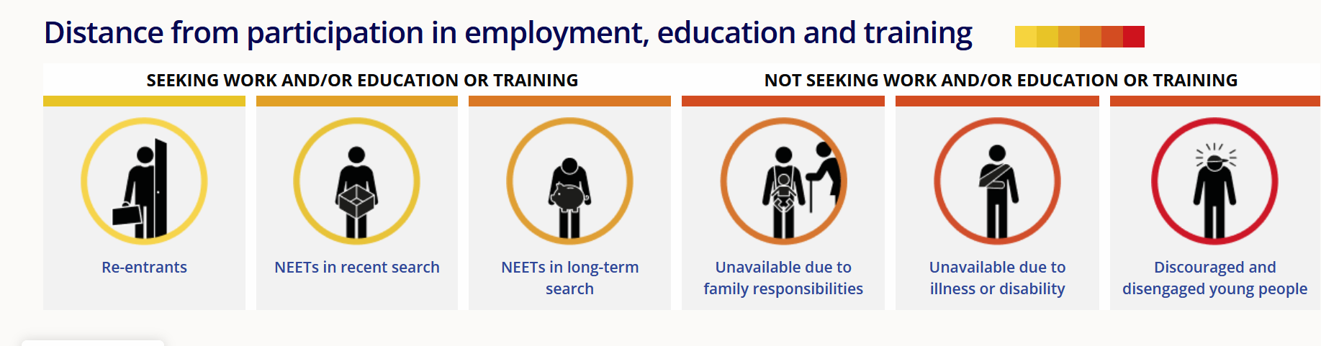

Slide 14
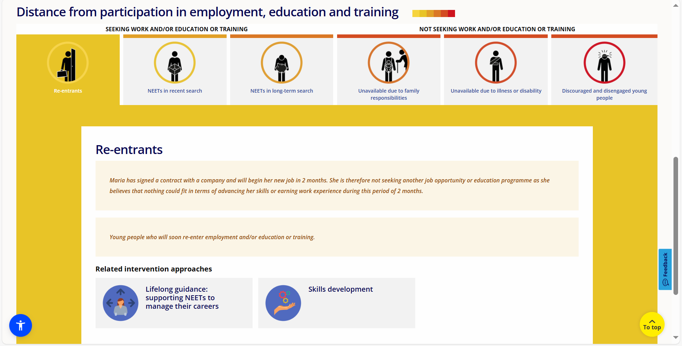

Slide 15
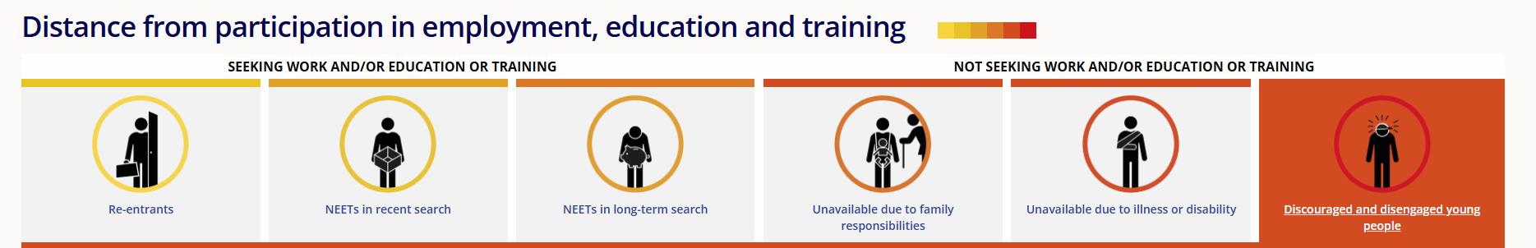
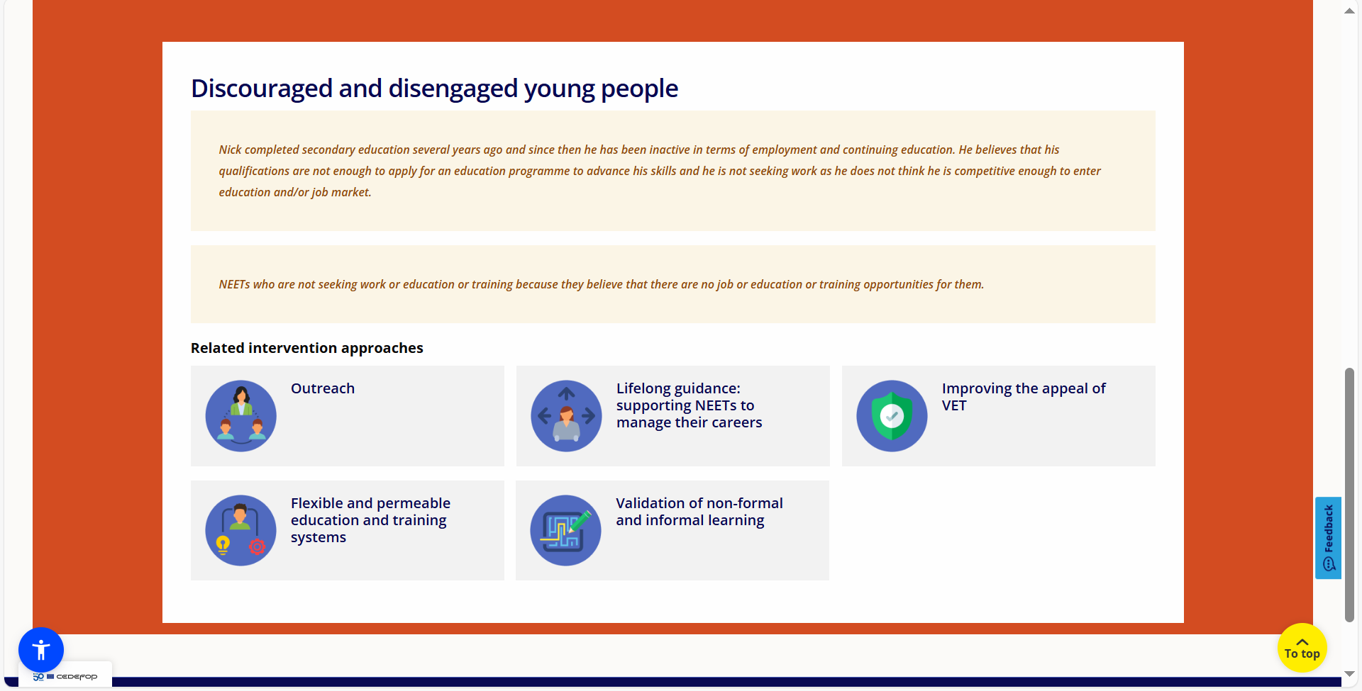

Slide 16
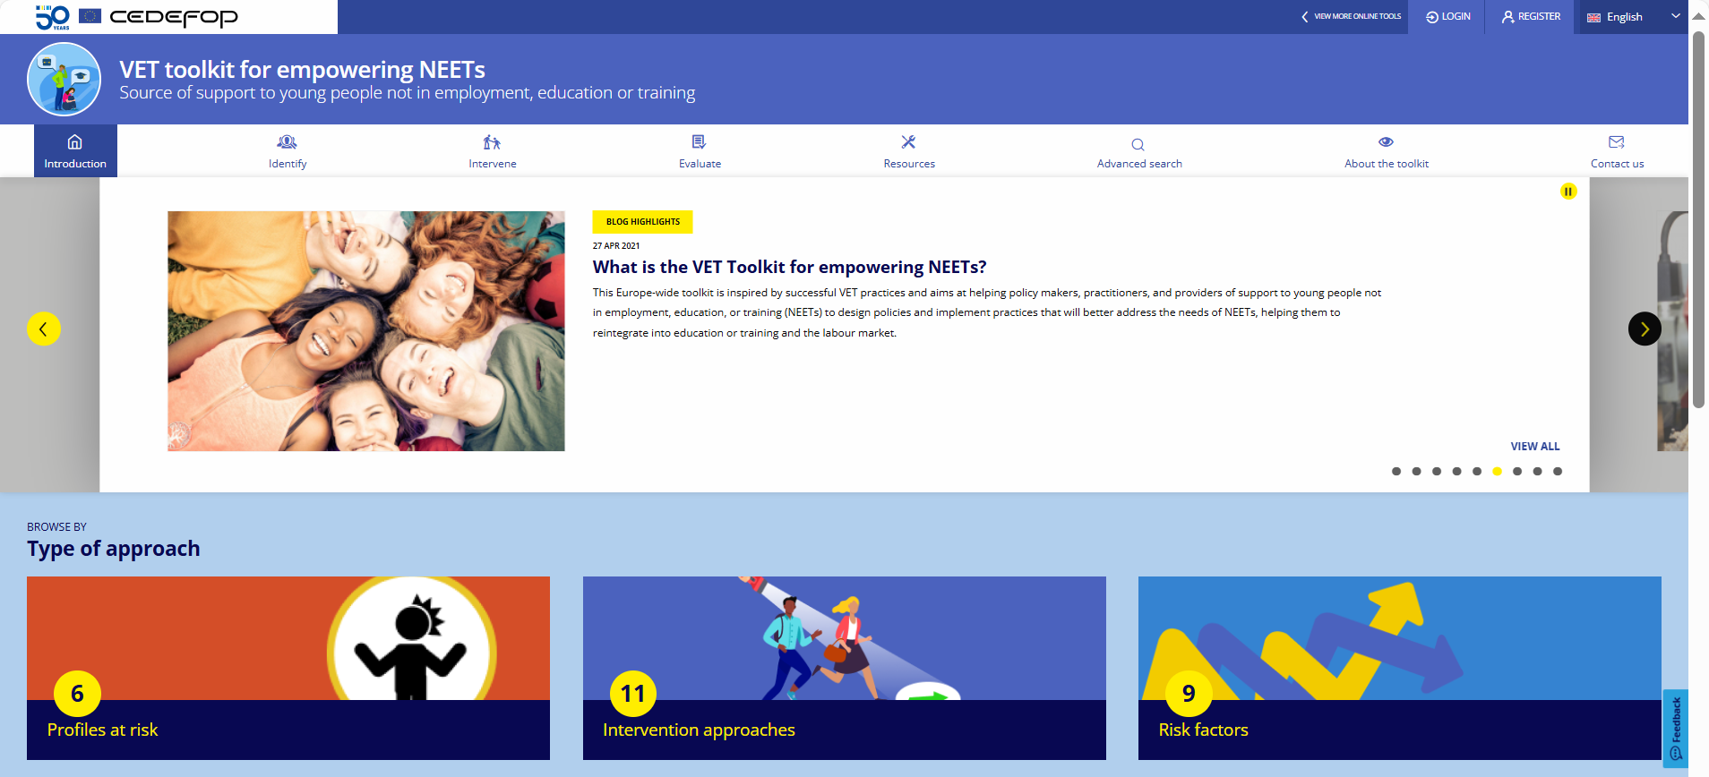
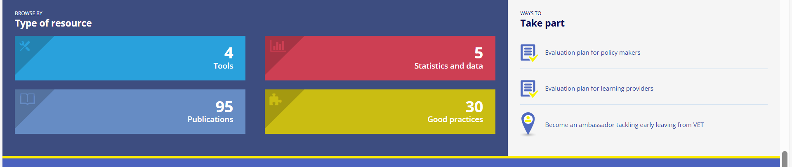

Slide 17
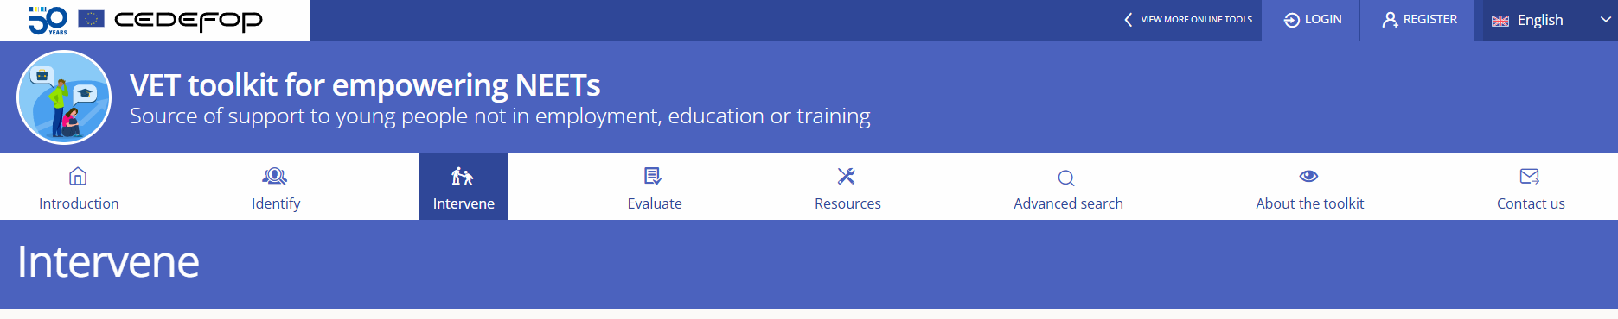
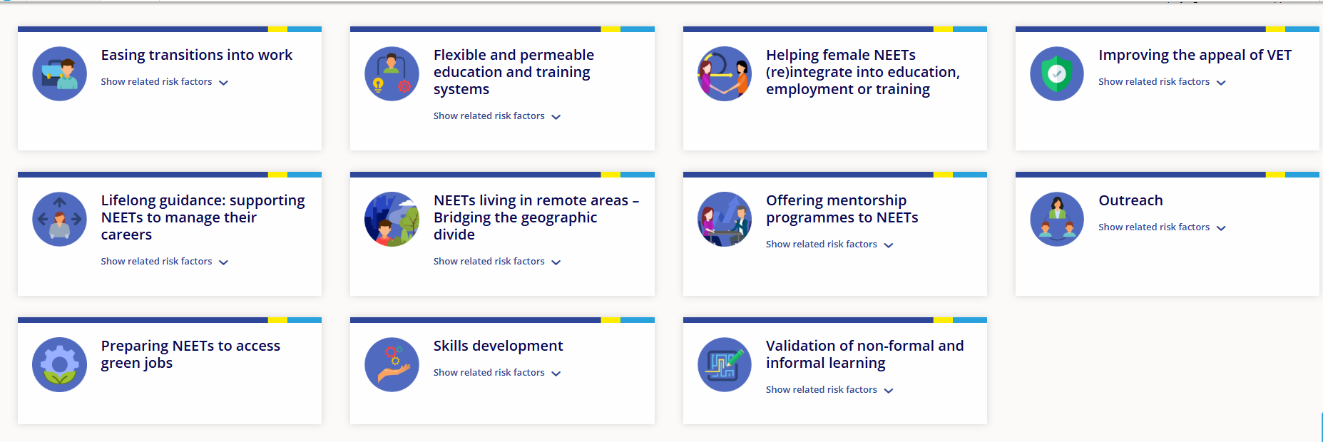

Slide 18
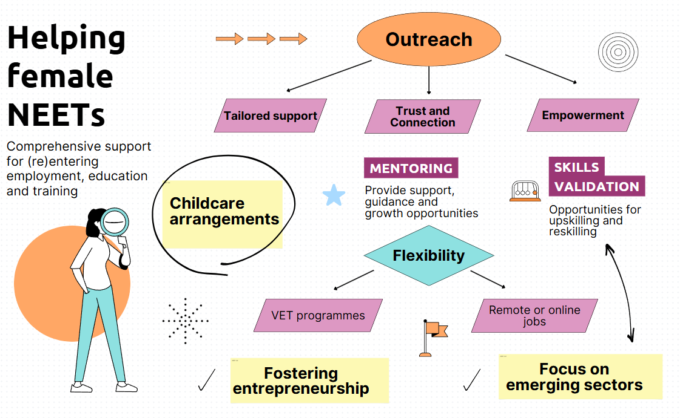
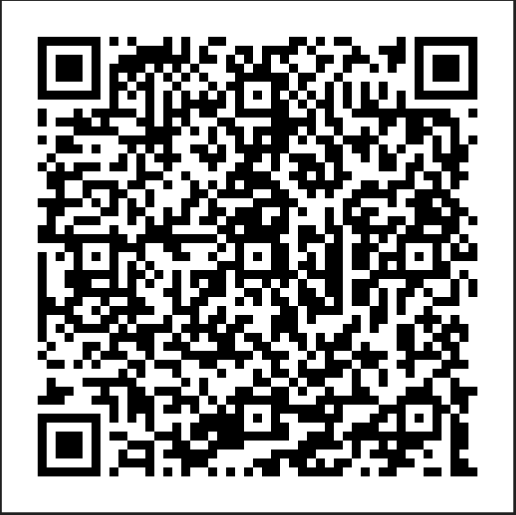

Slide 19
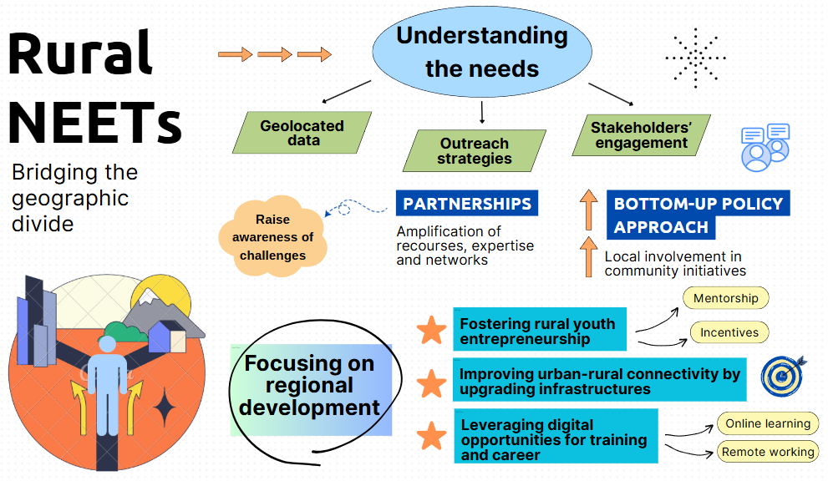
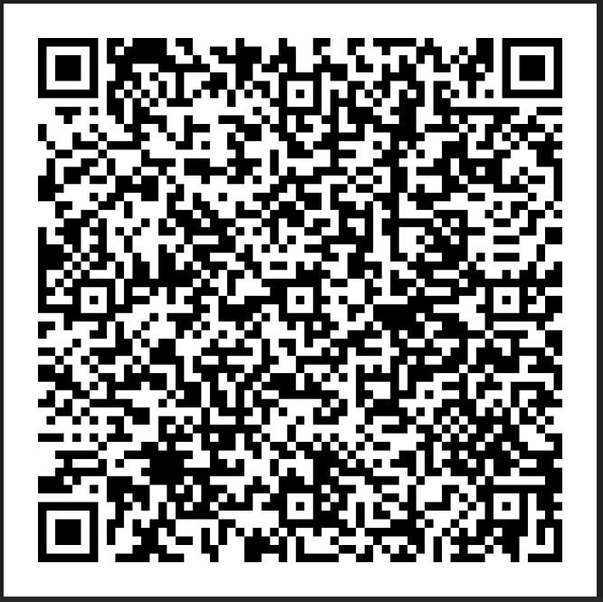

Slide 20
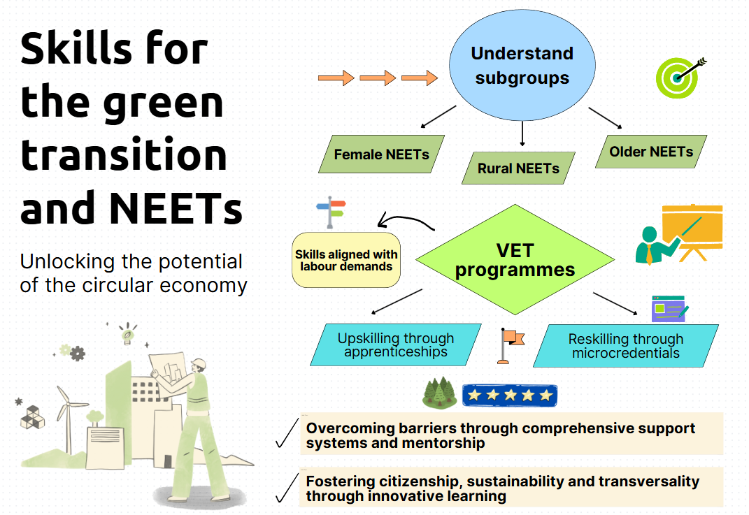
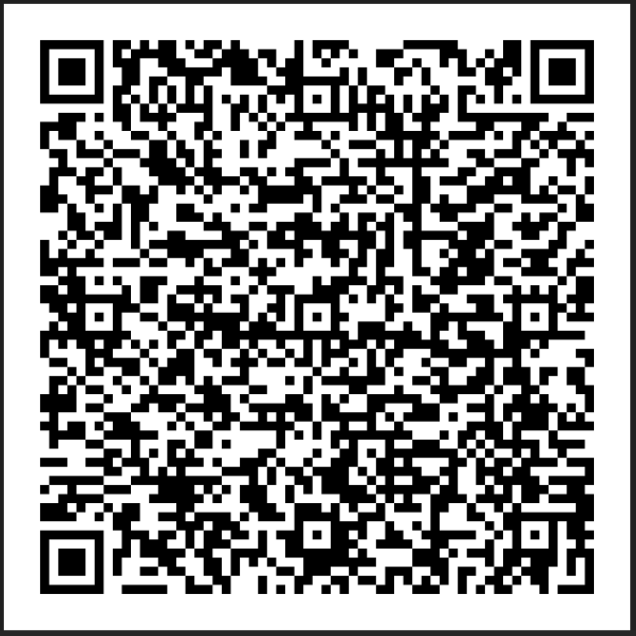

Slide 21
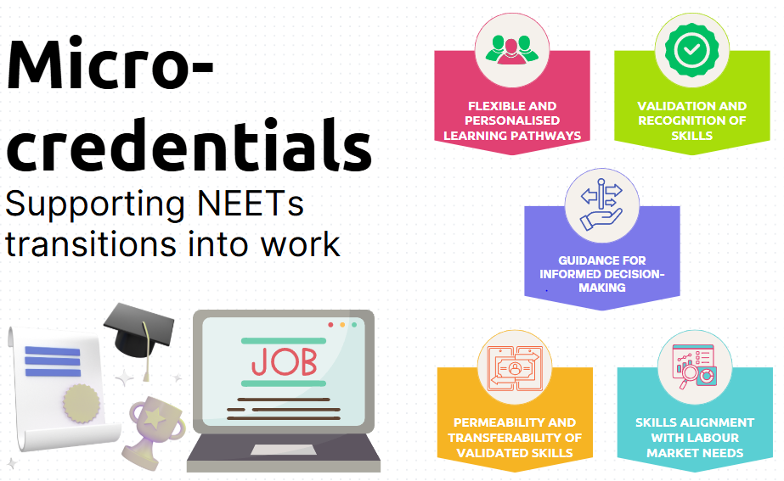
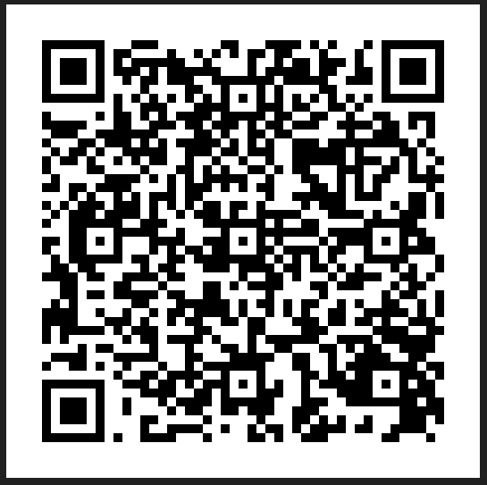

Slide 22
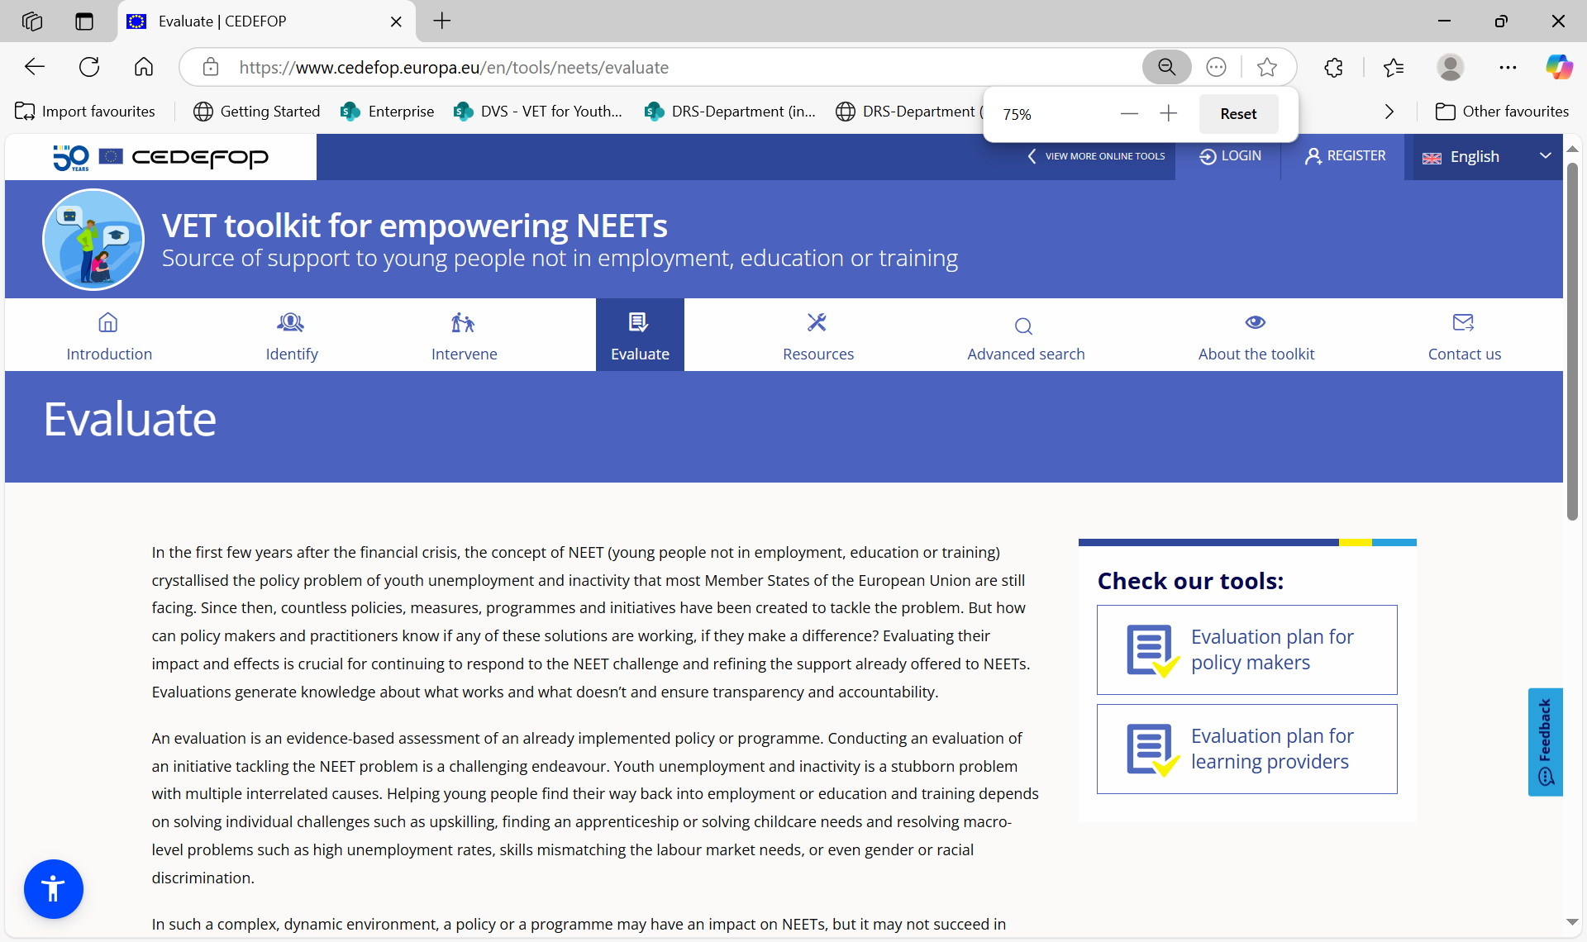
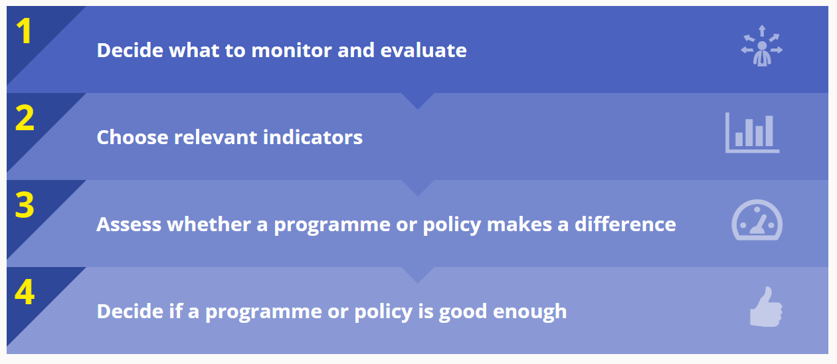

Slide 23
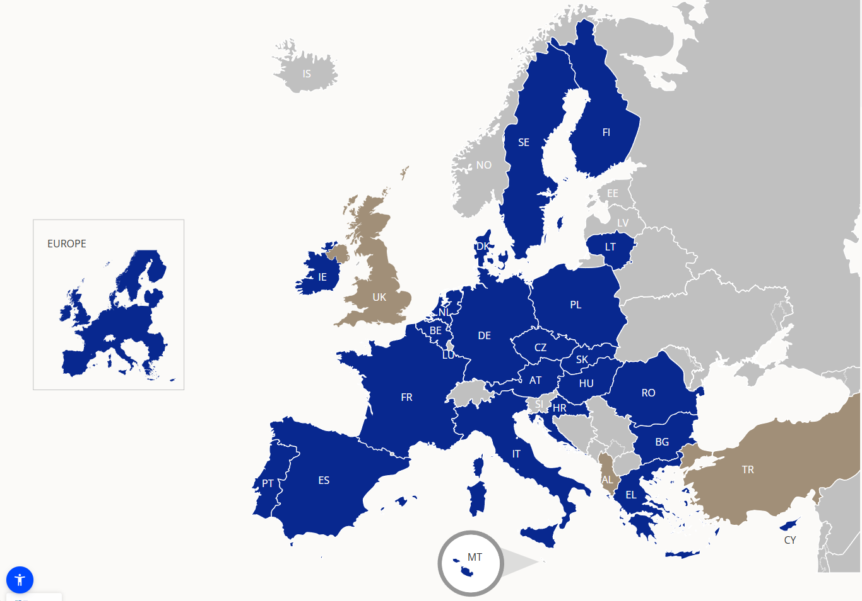

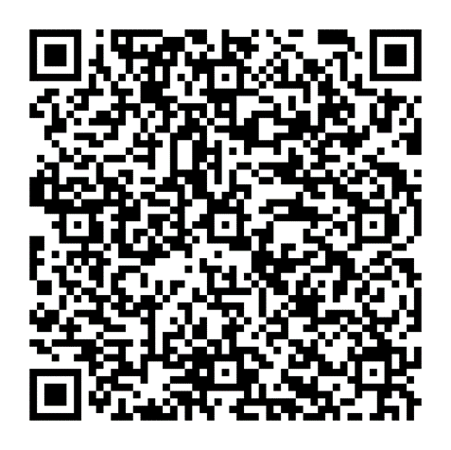
Ambassadors for inclusion

Slide 24
Cedefop research
Supporting evidence-based policy-making
Addressing data and research gaps

Slide 25




Preventing and supporting NEETs

Slide 26
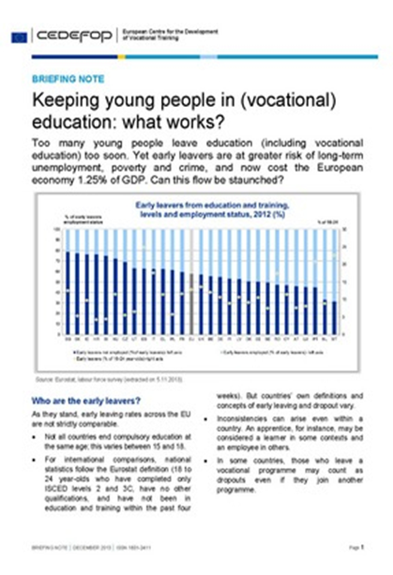
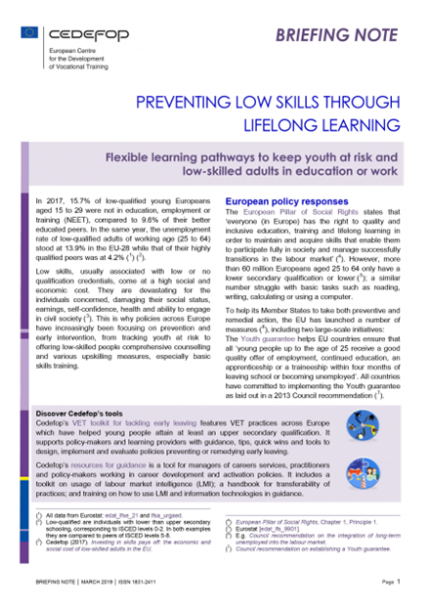
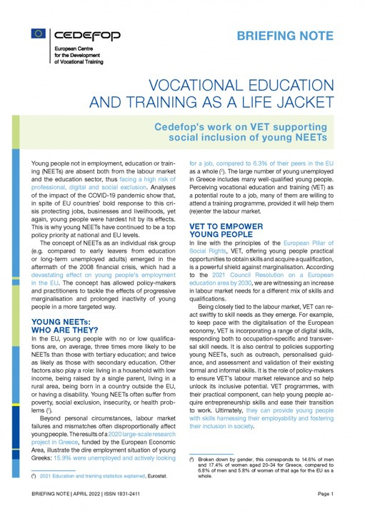
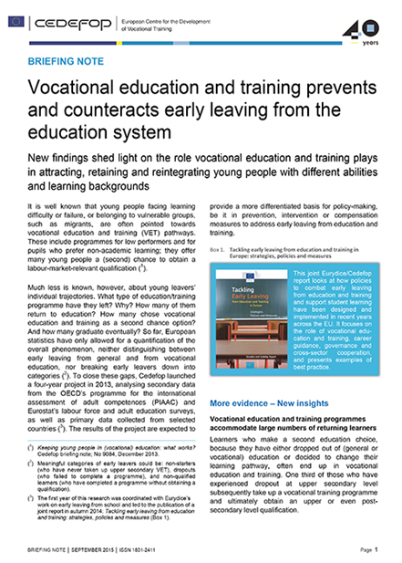
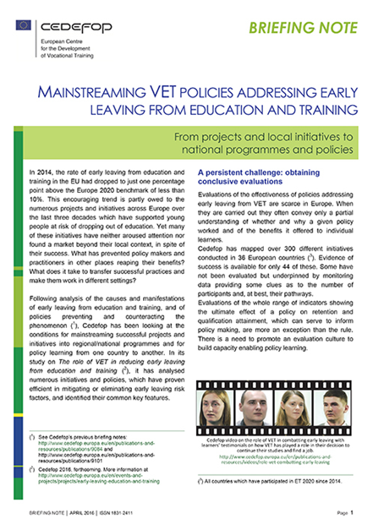
Cedefop policy messages

Slide 27
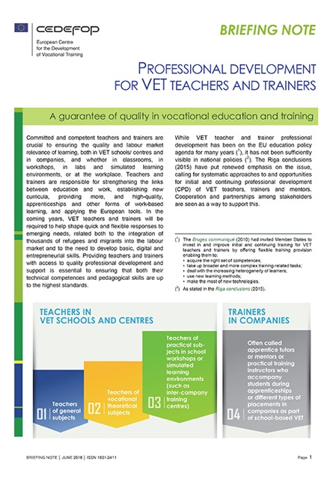
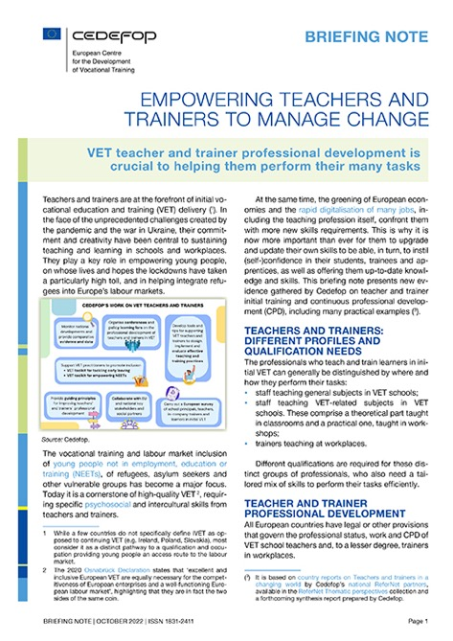
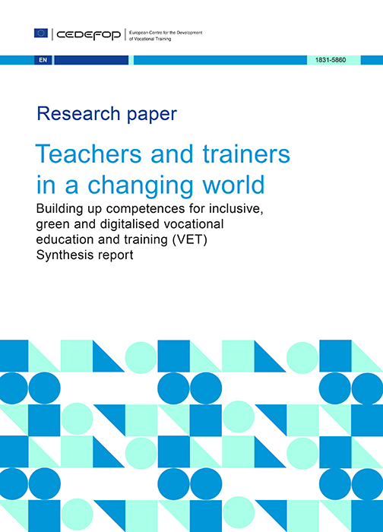

Cedefop empowering VET teachers
& trainers to promote inclusion

Slide 28
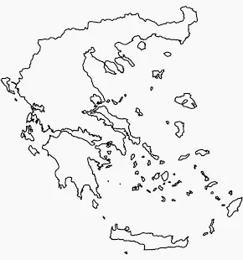

Just released!
Focus: NEETs teachers in VET programmes
Research questions:
What is the NEETs teachers’ profile outline?
What CPD needs for NEETs teachers?
What teaching methods do NEETs teachers use in VET?
How do NEETs teachers motivate their students and make VET programmes more relevant to the labour market?
14%
NEETs aged 15-29 in 2024
Methodology: Questionnaire and interviews
Source: Cedefop, 2025
Notes:
Definition: NEETs teacher and NEETs learner – who are we talking about
RQs: Who works with NEETs and what support do they need
Geographical focus
Methodology (questionnaire and interviews)
Screenshot of working paper (maybe QR code)
Relevance of this approach – visibility of topic

Slide 29


NEETs teachers’ profile
70% women 30% men
Average age
45 years old
More years of experience as adult educators than with NEETs
Source: Cedefop, 2025
29

Slide 30

NEETs teachers need specialised training
Are NOT aware of the psychosocial characteristics of NEETs
Over 90%
believe that focused CPD on NEETs is important
45%
Have attended CPD activities
on NEETs
Source: Cedefop, 2025
30

Slide 31
NEETs teachers: key actors in motivating NEETs
Believe NEETs teachers play a key role in motivating NEETs to pursue learning
83%
Say NEETs’ motivation is ‘completely’ or ‘very much’ linked to completing VET programmes
74%
Source: Cedefop, 2025
31

Slide 32

NEETs teachers: making VET programmes more relevant to the labour market
Believe NEETs teachers play a role in aligning VET programmes with labour market needs
NEETs teachers collaborate
with company specialists
Source: Cedefop, 2025
32

Slide 33





Key take aways
Experience matters most
more direct experience working with NEETs
better prepared
Targeted CPD is essential
focused on NEETs characteristics
Need for extended support
psychosocial
language mediation
Investing in hands-on experience yields the greatest impact
Source: Cedefop, 2025

Slide 34

Why upscale research on NEETs teachers?
1
Build a stronger evidence base: better understand teachers’ profiles, CPD needs and challenges
2
Identify and share good practices: support mutual learning and effective transfer of what works
3
Creating comprehensive support systems: liaise teachers with career guidance practitioners, phycologists, social workers, employers, in-company trainers
4
Drive coordinated, impact-oriented policy: mobilise resources, coordinate stakeholders and tailor CPD to real needs
Notes:
Anthie

Slide 35


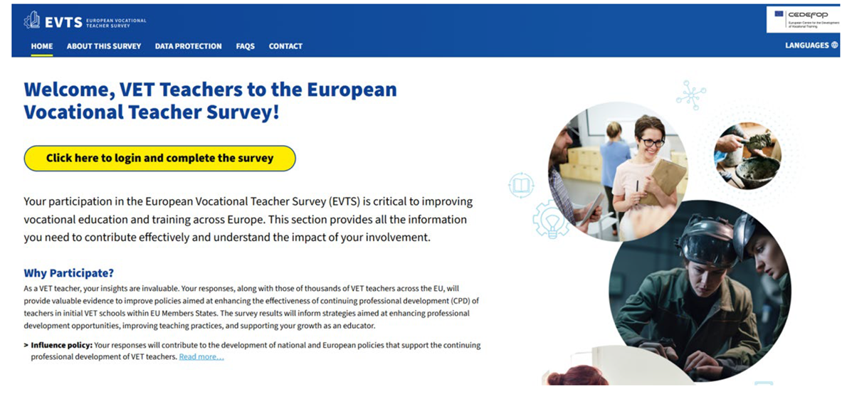
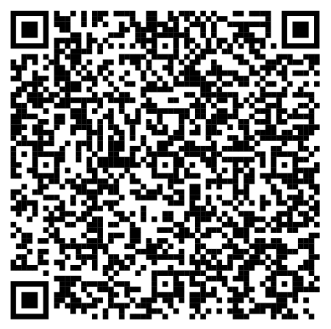
We listen to teachers' voices
Notes:
Michalis or Rena

Slide 36

Any Questions?

Slide 37
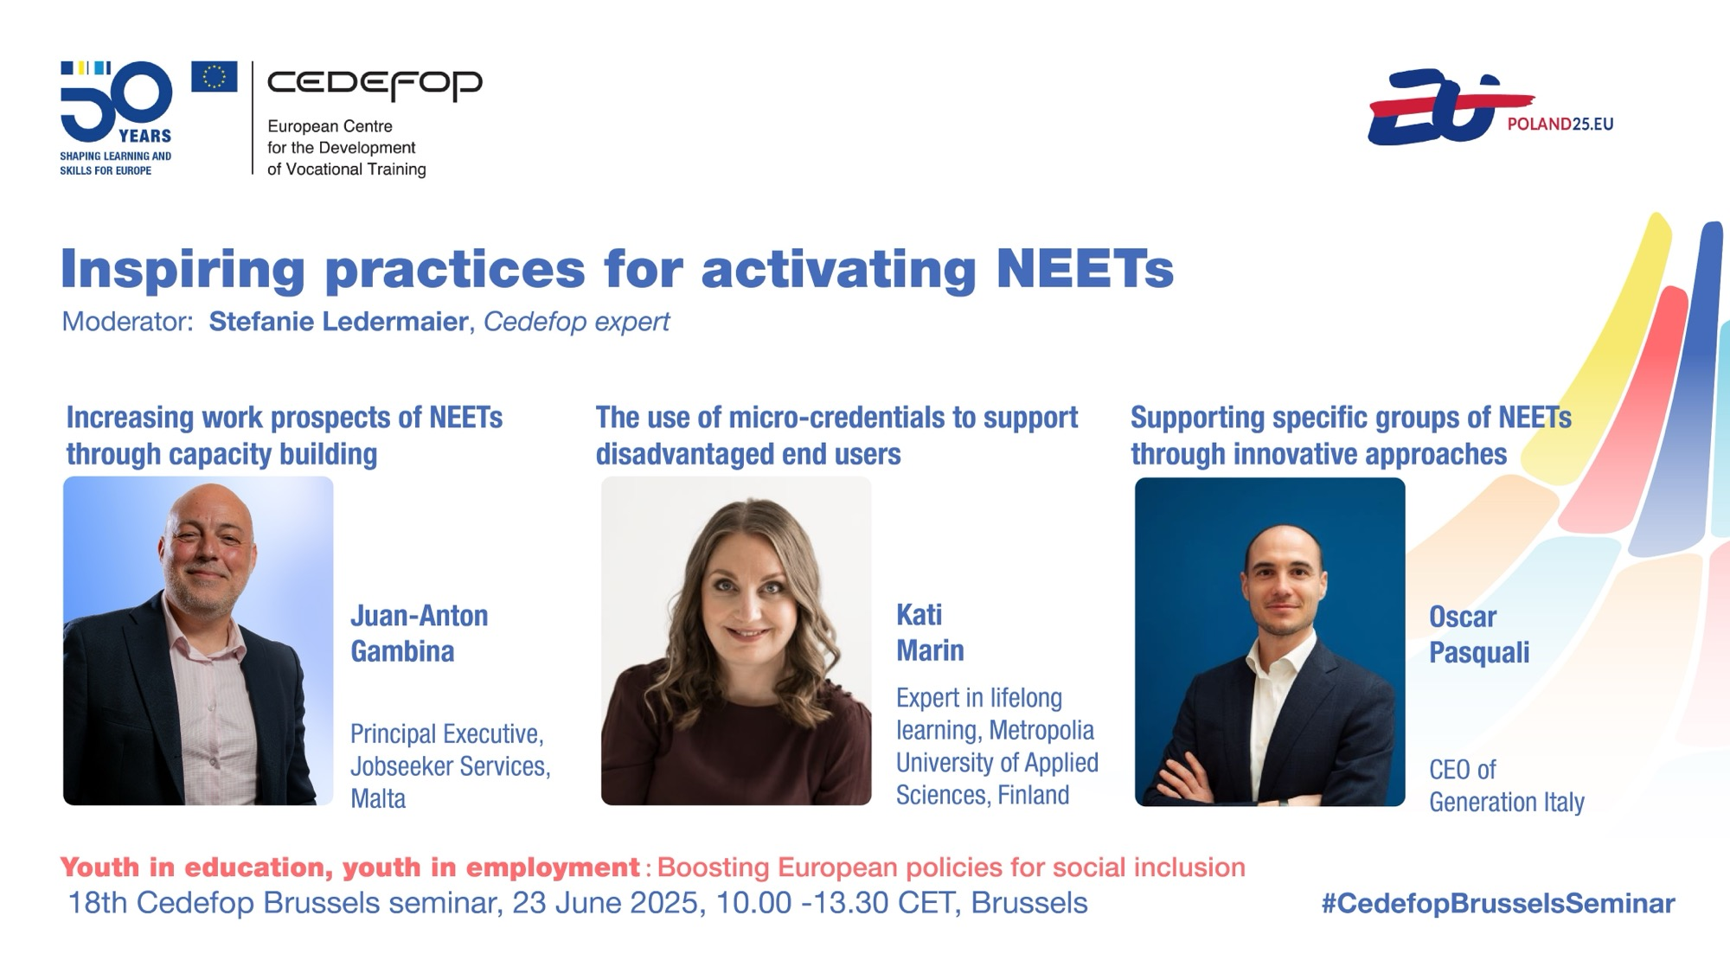

Slide 38

Increasing work prospects of NEETs through capacity building
Juan Gambina – Jobsplus (Malta)
23/06/2025

Slide 39
Jobsplus upskilling & collaborations
Employment advisors dedicated to NEETs
Mentoring services for NEETs
Training in Pedagogy vs Andragogy
Training in Motivational Interviewing
Collaboration with Agenzija Zghazagh (National Youth Agency)
Career guidance & emerging technologies
Malta Career Guidance Association
National Skills Council

Slide 40
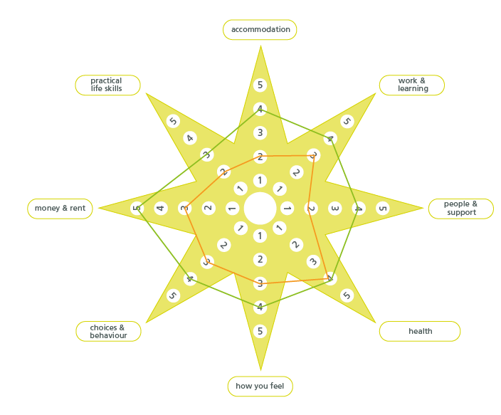
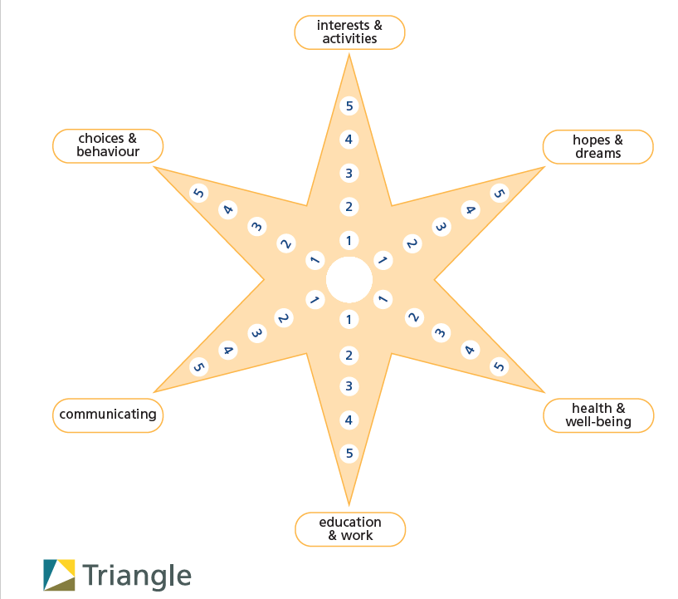
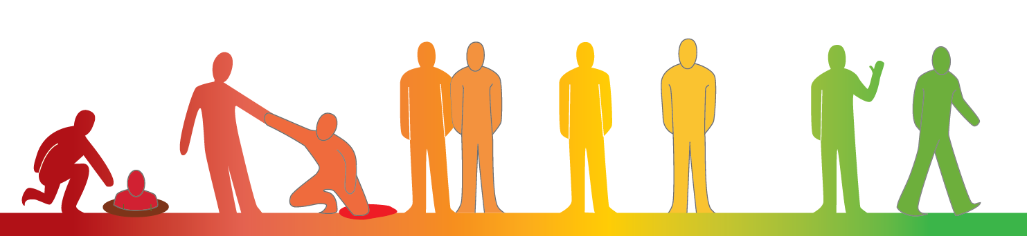
Jobsplus dedicated tools and policy enhancements for NEETs
Outcomes Star – Youth Star
Outcomes Star – Young Persons Star
Self-Awareness Test
Youth Guarantee age bracket extended from 25 to 29

Slide 41

atWork4NEETs
atWork4NEETs is a project which aims to identify and exchange good practices to improve the current policy tools to facilitate NEETs to access meaningful opportunities to improve their skills and find suitable jobs in seven European regions.
Lead partner JOBSPLUS Malta, partners Anci Toscana, Ministries and Employment Service Agencies from Croatia, Romania, Slovenia, Luxembourg and Lithuania have joined their forces to conduct an analysis on the NEETs’ conditions and policies and discuss possible solutions to enhance them with their relevant stakeholders.
The discussion’s findings will be then shared among project partners, turned into a list of recommendations to be used as a reference to actually improve the current tools and implement impactful policy changes to support NEETs at regional level.

Slide 42

Youth Guarantee 3.0
Empower Youth – 50hr technical training + 270hr on the job exposure in Green Economy, Blue Economy, Knowledge Economy, Orange Economy and Care Economy
SEC Revision Classes: Helping NEETs prepare for SEC exams through structured revision sessions in Maths, English, Maltese, Physics, Biology, etc…
Study Visits: Workshops for 45 Jobsplus staff in Lithuania and Finland focussing on data analysis, labour market trends, digital & green skills, and skills mismatches.

Slide 43

ALMA
ALMA – Aim, Learn, Master, Achieve - is an EU initiative, aiming at supporting NEETs to integrate into society by gaining access to work or training.
This initiative offers participants:
    An intensive tailored 3-month training phase in their home country
    A supervised work-related experience with accompanying mentoring services for 2 months in another EU country
    On their return, continued support will guide them in using the newly acquired skills to gain employment or further education in their home country

Slide 44
Thank you
Juan Gambina
Principal Executive for Vulnerable Groups
juan-anton.gambina@gov.mt

Slide 45



Modular micro-credentials as a tool for engaging NEETs in learning and work
Kati Marin
Expert in Lifelong Learning
Notes:
Time 0:25
Hi everybody. My name is Kati Marin. I’m working as an expert in Lifelong learning in Metropolia University of Applied Sciences in Finland.
In this presentation I want to highlight how modular microcredentials, developed together with employers, can open up meaningful learning journeys — and real opportunities to get hired.

Slide 46






The profiles of NEETs vary
A one-size-fits-all educational solution is insufficient.
 | Olli hasn’t entered upper secondary education. Finding employment without an education is challenging. | Kirsi has completed upper secondary education, but has not been able to secure employment in her field. She is unsure which skills she lacks that would enable her to enter the labour market. | Oona is not motivated by traditional degree-based education. She prefers to enhance her competences and obtain validation through hands-on work. | Pekka has completed upper secondary education but he hasn’t found a job. He would like to study Batchelor’s. | Anna is facing a challenging life situation and is uncertain about what she wants to do or study.
Olli
Kirsi
Oona
Pekka
Anna
Notes:
Time: 0:30
The life situations of NEETs and other LLL regarding education or employment vary greatly. One may be facing comprehensive challenges in life, another may not know what to study in order to find job, and for someone else, traditional forms of degree-based education simply do not suit.
We have tried to offer for these young people different options for studying. Upper secondary degree education for example is provided not only in educational institutions but also in workplaces and virtual environments.

Slide 47

Current LLL-offerings of UAS often appear fragmented
or
leaves learners with limited flexibility to create personalized learning pathways aligned with their unique skill levels and needs
10 cr
5 cr
5 cr
5 cr
10 cr
5 cr
5 cr
10 cr
3 cr
5 cr
5 cr
5 cr
5 cr
5 cr
5 cr
5 cr
5 cr
10 cr
Notes:
Time: 1:05
UAS have also had a wide range of opportunities for NEETs and other lifelong learners.
BUT, this current LLL-offerings that we have often appear fragmented so it's difficult for learners to understand how they can expand and deepend their expertise to match better the need of labour markets.
Or we as a Educational Institutions have defined the programs which leaves learners with limited flexibility to create personalized learning pathways aligned with their unique skill levels and needs.
And quite often these study offerings are not planned together with professionals from working life so their relevance to employment may be limited.
We would like to avoid these issues while developing microcredentials.

Slide 48


Creating Micro-Credentials that benefit all stakeholders
Should be created in close co-operation with labor markets.
Similar way to describe learning outcomes
Notes:
Time: 1:15
So what we should do differently based on the previous experiences, so that NEETs or other LLLs, the authorities guiding them, and the labor market could all benefit in the best possible way?
Firstly, Educational institutions should create micro-credentials in close co-operation with labor markets. In this way, we will ensure that micro-credentials truly deliver the competences that are in demand in rabidly changing labor market and gives relevant knowledge for NEETs.
Secondly, learning outcomes of micro-credentials should be clearly described to ensure transparency, alignment and clarity with all stakeholders. The European Qualifications Framework (EQF) offers a valuable model for this purpose. Could all providers — regardless of the type or level of Educational Institution — describe learning outcomes consistently in terms of the knowledge, skills, and level of autonomy acquired and In a way that all stakeholders can understand.?

Slide 49
Creating Micro-Credentials that benefit all stakeholders
More learner and labor market orientated way to describe the skill levels of micro-credentials.
NOVICE
BEGINNER
COMPETENT
PROFICIENT
EXPERT
(Source: National Framework of Micro-credentials in Finland & Dreyfus)
Notes:
Time: 0:35
Thirdly, could we also commit to describe the level of micro-credentials using a skill levels – framework, that we would provide more understandable information for stakeholders than simply stating a level EQF 1-8.
This is what we are currently piloting and I would like to share some of our initial reflections on what this could enable for various stakeholders.

Slide 50
MODULAR MICROCREDENTIALS
AGEING (Example phenomenon)
Dreyfus model of skill acquisition | TOPIC | TOPIC | TOPIC | TOPIC | TOPIC | TOPIC
NOVICE (informal materials: podcast, videos, blogs)
BEGINNER
COMPETENT/ PROFICIENT
EXPERT
2 cr
1 cr
1 cr
1 cr
3cr
2 cr
2 cr
2 cr
2 cr
2 cr
3 cr
2 cr
2 cr
3 cr
3 cr
1 cr
2 cr
2 cr
5 cr
Leaners can expand and deepend their expertise.
Notes:
Time 1:35
Based on all these foundations and thoughts we have created the matrix, that would able us to develope in co-operation with labour markets modular microcredentials that provide flexible learner centered oportunities to engage learning and work. We could provide multidisciplinary phenomenon-based learning opportunities that prepare individuals to solve complex, systemic challenges faced also in the labour market.
So guided by this matrix we could create microcredentials, which enable the expansion of expertise on various topics at a specific skill level.
Or we could create microcredentials, which enable the deepening of expertise in a specific topic.
We could also offer informal learnig materials like podcast, videos, which can attract NEETs to study micro-credentials.
Defining skill levels would help Educational institutions, employers, Public employment services and learners themselves reliably and consistently assess skills.
Using skill levels in accordance with the national qualifications framework EQF facilitates academic recognition and quality assurance.

Slide 51
MODULAR MICROCREDENTIALS
(Example phenomenon)
Dreyfus model of skill acquisition | TOPIC | TOPIC | TOPIC | TOPIC | TOPIC | TOPIC
NOVICE (informal materials: podcast, videos, blogs)
BEGINNER
COMPETENT/ PROFICIENT
EXPERT
1 cr
1 cr
1 cr
3cr
2 cr
2 cr
2 cr
2 cr
2 cr
3 cr
2 cr
2 cr
3 cr
3 cr
1 cr
2 cr
2 cr
5 cr
Leaners can expand and deepend their expertise.
Notes:
LUKUAIKA 0:45
And most importantly this would provide flexible paths for expand and deepend the experties, motivating and helping NEETs and other LLLs to create their own learning path.
We all need to be clear about what we actually know and can do — but also what we can’t. That’s how we stay connected to real impact. Otherwise, there is a risk drifting without purpose. Meaning and value come through concrete capability.
In a world that is changing faster than ever, we must offer learning opportunities that are more flexible and accessible, and more tailored to individual needs. Modular microcredentials with clearly defined learning outcomes can provide a meaningful response to this need.

Slide 52
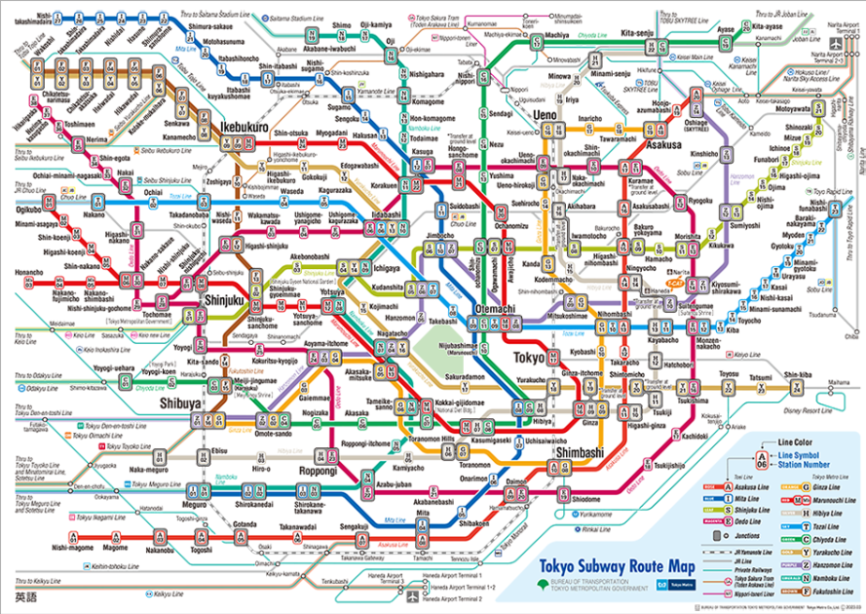
Future: Skill Development
"We’re moving from what you studied to what you can do. And that shift is redefining how we learn, hire, and grow."
Prf. Martin Bean
Notes:
LUKUAIKA: 1.10
Learning is not linear and one-size-fits-all educational solutions are not the future. Learning will be like an adventure through the Tokyo metro map — complex, surprising, sometimes confusing, but full of discovery and connection.
Lerners will have more flexible opportunities, but also chance to get lost. Especially NEETs, need strong support and guidance around them to find their way.
I feel that we educators, employers, policymakers have opportunity to start to create flexible practise-oriented learning opportunities to help turn diverse learning and career paths in real, reachable journeys.
To close, I’d like to share the words of Professor Martin Bean, which I believe beautifully capture the essence of everything I’ve tried to convey today. We’re moving from what you studied to what you can do. And that shift is redefining how we learn, hire, and grow.

Slide 53
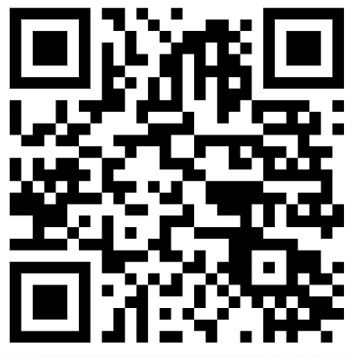
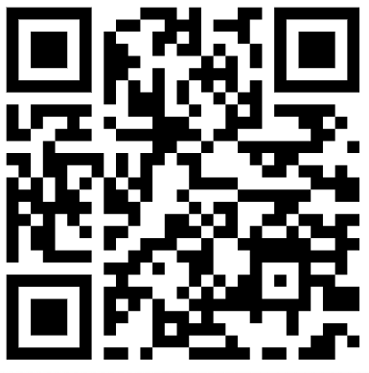





Thank you!
Kati Marin
Virve Oksanen
Notes:
Thank you for your attention—also on behalf of my colleagues who couldn’t be here today.
As we are currently piloting the national framework for microcredentials, like many other countries, we truly appreciate all the comments, questions, and ideas shared today.
Please don’t hesitate to get in touch if you have further thoughts or would like to continue the conversation. Thank you!

Slide 54




Slide 55



About Generation
Globally, Generation supports adults
of all ages to achieve economic mobility through employment by training, placing, and supporting learners into careers
that would otherwise remain inaccessible.
GRE
www.generation.org

Slide 56


We operate globally across 17 countries
We serve low-income communities across countries of all income levels—low, middle, and high—
to advance our vision: meaningful careers and sustained well-being for everyone, anywhere in the world.
In 2024, Generation Europe was established to support our operations on the continent.
IRELAND
UK
FRANCE
ITALY
USA*
SPAIN
MEXICO
INDIA
HONG KONG
THAILAND
GHANA*
COLOMBIA*
KENYA
SINGAPORE
BRAZIL
CHILE
AUSTRALIA
* Generation Direct programs are delivered by our global hub (GYE)

Slide 57




Our seven-step methodology enables us to achieve consistently
high employment and income outcomes across a wide range
of demographics, professions, and countries
1. Jobs and employer
engagement from the start
1
6. Return on investment
for employers, graduates,
and society
2
2. Learner recruitment based
on intrinsics, commitment,
and employment standards
for the profession
7
6
3
7. Data at the core
of our work
5. Mentorship
extending to six months
post-graduation and a
supportive alumni community
4
3. 4-to-16 weeks
of profession-
specific training
5
4. Interviews with employers
for rapid job placement

Slide 58


OUR IMPACT GLOBALLY
Since our launch, we have delivered impact that is…
1
2
3
BROAD
DEEP
DURABLE
Expanding our reach and supporting a rapidly growing number of graduates…
…facing barriers to employment, for whom we enable life-changing employment and income outcomes…
…with sustained benefits to their well-being and economic mobility.
174,100
learners enrolled
384
cities
112,880
83%
76%
36%
job placements.
job placement within 6 months of graduation.
of our alumni are currently engaged in paid work 2-5 years after graduation.
are able to save money 2-5 years after graduation.
18,000
136,000
graduates
1.3-4x
75%
71%
86%
employers, from start-ups and SMEs to Fortune 500 companies.
increase in income 12-18 months post- training, varying across programmes and countries.¹
of our employed graduates are in jobs very related to the completed programmes.
can meet daily financial needs 2-5 years after graduation and 85% of employed alumni earn above a living wage.²
feel confident in their ability to achieve their professional goals 2-5 years after graduation.
¹ For graduates previously employed.
² A living wage is a wage level sufficient to afford a decent standard of living for an individual, and, when relevant, for any dependents. It is approximately 40% above the local minimum wage.
READ CEO MONA MOURSHED’S ARTICLE ABOUT HOW WE DEFINE IMPACT IN STANFORD SOCIAL INNOVATION REVIEW

Slide 59










OUR IMPACT IN EUROPE
Generation is present in 5 European countries
COUNTRIES
PROGRAM PORTFOLIO
Depth
9,224 graduates
15,945
78%
TECH
job placements
job placement 180 days
20,616 graduates
1.3-3.8x
76%
5,299 graduates
HEALTHCARE
increase in income 12-18 months post- training, varying across programmes and countries.¹
Of our employed graduates are in jobs very related to the completed programmes.
81
cities
3,542 graduates
CUSTOMER SERVICE & SALES
Durability
27 professions
86%
61%
2,035 graduates
SKILLED TRADES
of our alumni are currently engaged in paid work 2-5 years after graduation.
are able to save money 2-5 years after graduation.
4,000
Employers
586 graduates
86%
86%
GREEN JOBS
can meet daily financial needs 2-5 years after graduation
feel confident in their ability to achieve their professional goals

Slide 60





IMPACT FOR OUR LEARNERS AND THE COMMUNITIES WE ARE OPERATING IN
Social Return on Investment, an external third-party impact assessment
METHODOLOGY
BENEFITS GENERATED
  The Social Return on Investment (SROI) is the ratio between the monetary benefits generated as outcome (eg. salary increase, increase in tax revenue, public costs reduction) and the investment in the project
  Direct beneficiaries and outcome:
    Unemployed young people (income increase, acquisition of skills, personal fulfillment)
    Families of unemployed young people (income increase, psychological benefits)
    Entrepreneurs and companies (Reduction of labor costs)
  Indirect beneficiaries and outcome:
    Society, community, and territory (Growth of tax revenue, reduction of social costs)
    Trainers (Professional growth and skills development)
    The impact of the project is measured also in terms of Deadweight: difference between the target (unemployment rate) that would have been achieved without the Generation project and the one actually achieved thanks to the Generation project
2.9
4.2
1 year SROI after first employment
2 year SROI after first employment
BENEFIT DISTRIBUTION
PER STAKEHOLDER
BENEFIT DISTRIBUTION
PER SDG INDICATOR
79%
Young unemployed
45%
Decent work and economic growth
13%
Society, community, and territory
25%
Quality education
20%
No poverty
3%
Entrepreneurs and companies
5%
Industry, Innovation, and infrastructure
3%
Families of young unemployed
4%
Good health and
well-being
1%
Trainers
1%
Sustainable cities and communities

Slide 61







JOIN US!
GENERATION GRADUATES
www.generation.org
europe@generation.org

Slide 62
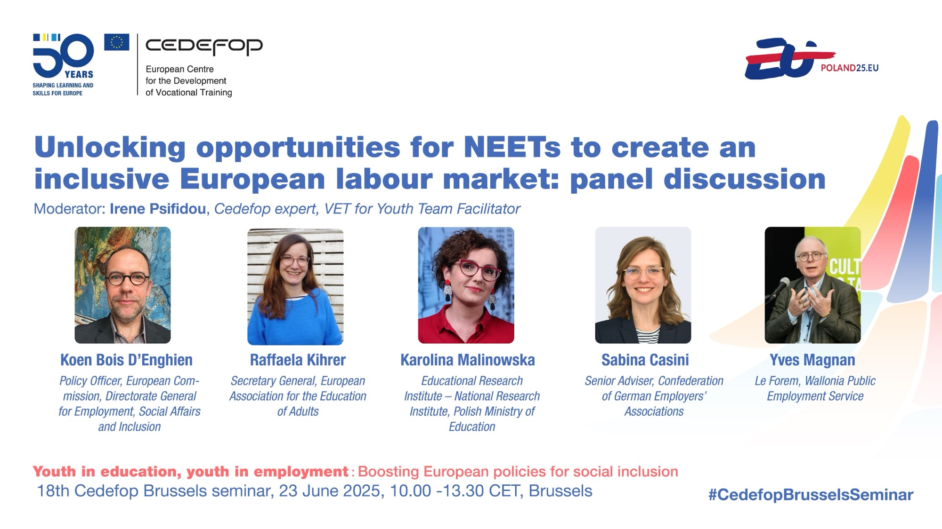

Slide 63


Slide 64


